Slide 2
Hello and Welcome to Family Connection!
I am the Naviance Navigator.
I am here guide and assist you.

Slide 3
Family Connection
We are pleased to introduce Family Connection from Naviance, a web
based service designed especially for students and parents. Family Connection
is a comprehensive website that you and your child can use to help in making
decisions about courses, colleges, and careers. Family Connection is linked
with Naviance Succeed, a service that we use in our office to track and
analyze data about college and career plans, so it provides up-to-date
information that is specific to our school.
The following slides provide an overview of Family Connection.

Slide 4
Using Family Connection
An On-line Resource for Students and Parents for Post High School Planning & Advising

Slide 5
Overview
What is Family Connection?
What Can Students And Parents Do Using Family
Connection?
How do you access it?
How do you register?
How does it help with career and college planning?

Slide 6
What is it?
A web-based resource for students and parents
that encourages and supports post high school
career and college planning
Family Connection is specific to your school
Family Connection is linked with Naviance Succeed, a service that is used in the counseling office

Slide 7
WHAT CAN STUDENTS AND PARENTS DO USING FAMILY CONNECTION?
View guidance news bulletins
Create a résumé
View college visits and sign up
Complete a college search
Complete a college search
Develop a prospective college list
Provide access to scholarship search engines; over a hundred national
scholarships are available
Maintain journal entries
Game Plan Survey
Complete school developed surveys
Compare colleges
Links to selected third party resources
(i.e. College Board, Financial Aid, NCAA, Careers, College searches, etc.)
Track deadlines
View scattergrams

Slide 8
Features Available to Students and Parents Using Family Connection
The following slides highlight some of the features in Family Connection
Using Family Connection, you will see me, the NaviGator

Slide 9
How is it accessed?
Family Connection is web-based
http://connection.naviance.com/(insert school account)
Student accounts-
Username: student ID
Password: birthdate (2 digit month/2 digit day/4 digit year)
Parent accounts-Contact the Lamar College Corner if parent would like their own access

Slide 10
Sign-in Page
The next time you log in, use user name and password

Slide 11
After You Sign in
Click on the Tabs
Important Messages
Updates from the Guidance Office

Slide 12
Colleges Page
Use these links to do a college search

Slide 13
College Profile
Visit College Website

Slide 14
Colleges I’m Thinking About
Click Here to add colleges to your prospective college list

Slide 15
College Visits
See what College visits are scheduled and sign up to attend!

Slide 16
About Me – Resume and Surveys
Click here to fill out important surveys, tell us your Game Plan and create your resume

Slide 17
College Compare
Indicates percent of students from your school WHO APPLIED TO THAT SCHOOL that were accepted
Green means your stats are better than the average accepted student from your school
Red means your stats are below the average accepted student from your school
Black means your stats are equal to the average student accepted from your school

Slide 18
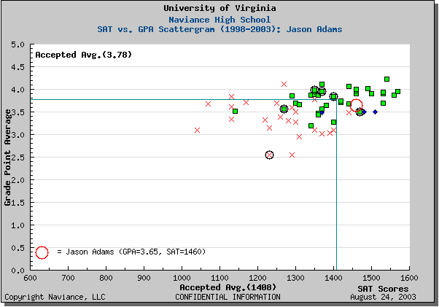
Scattergram
Accepted
THIS IS YOU!
School Averages
Denied

Slide 19
Colleges I’m Applying to My Applications

Slide 20
Using Family Connection consistently provides:
Shared resources linking home to school
On-line tools for collaboration among counselors, students, and parents
Accurate and complete records about student’s choices
Graphs and charts displaying colleges where students have applied, were accepted and are attending
For more information, please contact the counselor or college corner
Remember there is so much more I can help you with.
Bye,
I hope to see you soon!

